Slide 1
Let’s make a realtime game with Django channels
MrValdez

Slide 2
Prelude
The speaker, MrValdez is a person that doesn’t exists. At least, not in this universe. This is the only time Sony Valdez will acknowledge that none of the following bio is real.

Slide 3
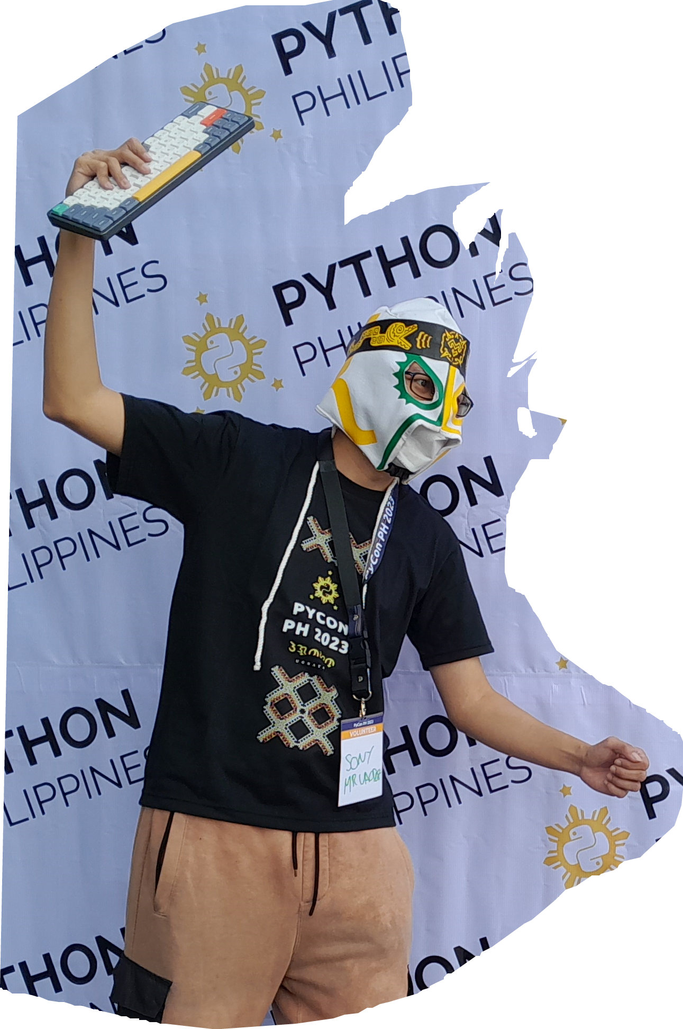
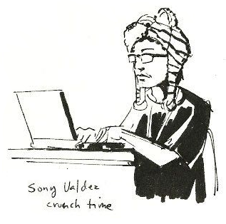
Mrvaldez lore (1/3)
MrValdez is a Luchador in a universe that is like our own. While Luchadores are known for physical wrestling, MrValdez came from a world where they perform as programmers.

Slide 4
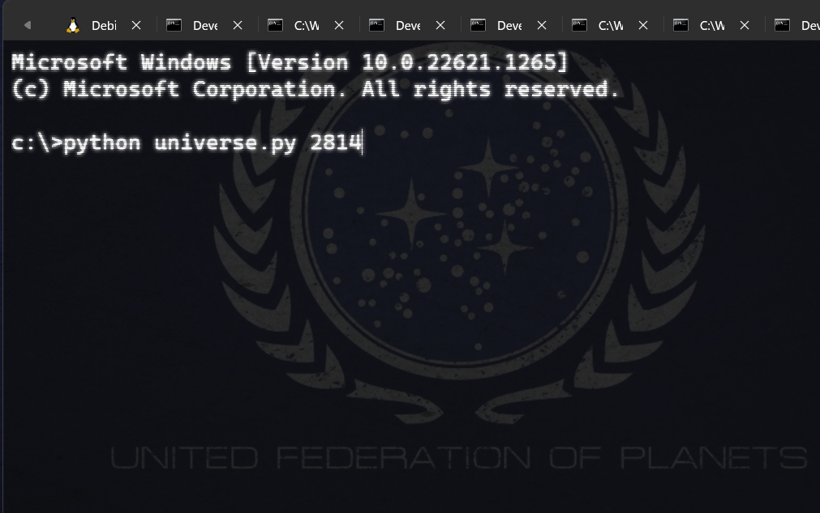
Mrvaldez lore (2/3)
Having accidentally transported here by a strange Python program, MrValdez hopes to one day return to his reality.

Slide 5
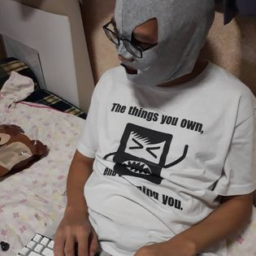
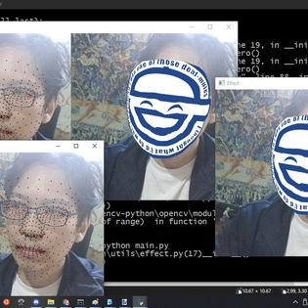
Mrvaldez lore (3/3)
In the meantime, he spends his time sharing secrets from his universe. By complete coincidence, that knowledge is applicable in this universe.

Slide 6
About Django channels
Django Channels is a stand-alone plugin that extends Django to allow for WebSockets, chat protocols, IoT protocols, and more.
Can be used with synchronous or asynchronous programming
Event driven architecture
https://channels.readthedocs.io/en/stable/

Slide 7
About the workshop
This workshop assumes you already did the Django tutorial.
We will start with the original Django-channels tutorial to understand the fundamentals.
Then we will make a simple game.

Slide 8
About the workshop
Normally, in my workshops, I would ask everyone to type code. But after practicing the timing, its more efficient to cloned a git repository.
Before PyCon started, you should have received an email on what to install and where to get the code.
If you haven’t done the preparation, you can find the repo here:
https://github.com/MrValdez/pycon-ph-2023-django-channels

Slide 9
Let’s explain some concepts

Slide 10
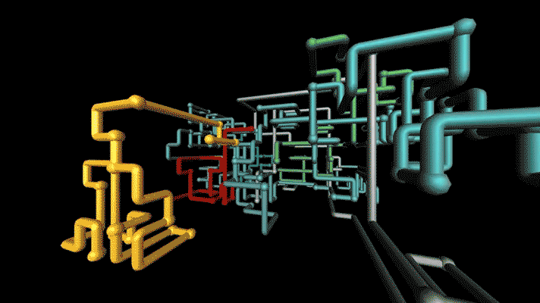

Concepts to explain the internet
HTTP/HTTPS
WS/WSS
https://www.phaidon.com/resource/pipes.gif
https://en.wikipedia.org/wiki/Personal_computer
Notes:
We all know what the Internet is. It’s a series of tubes.
Most tubes use HTTP and HTTPS. For Django Channels, we will be working with Websockets (WS/WSS)

Slide 11
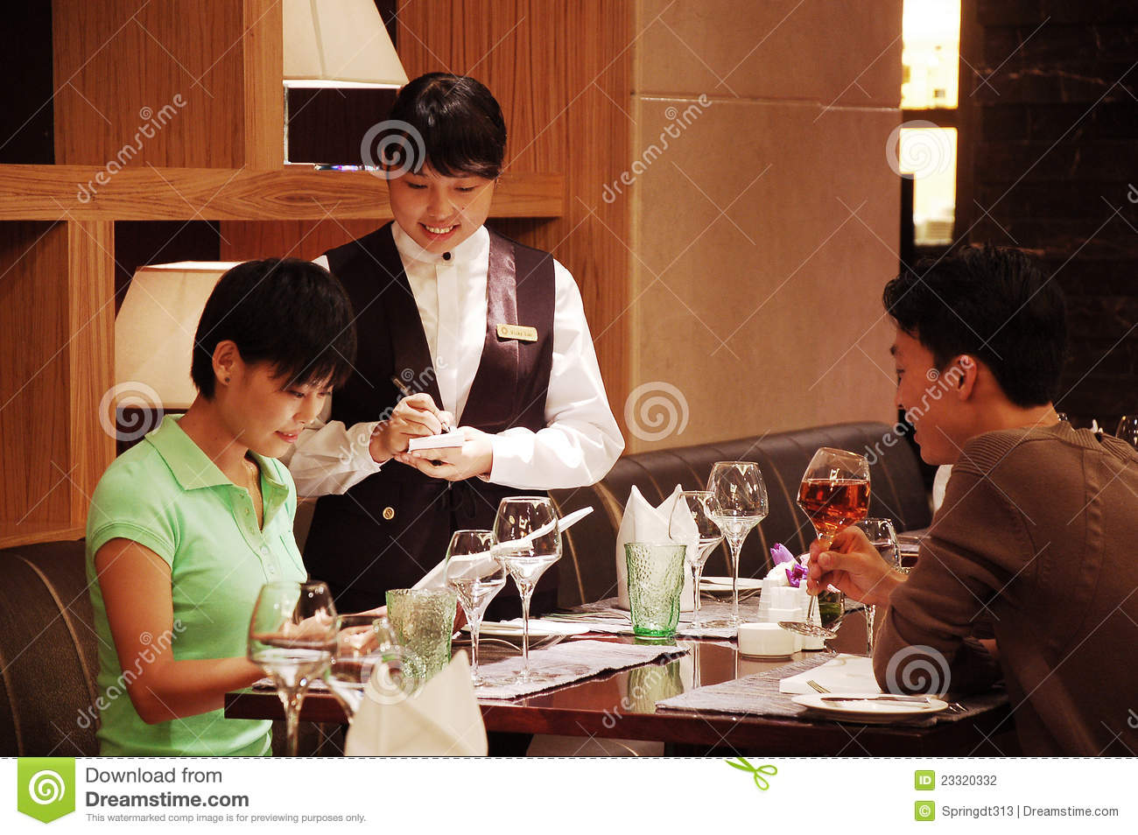
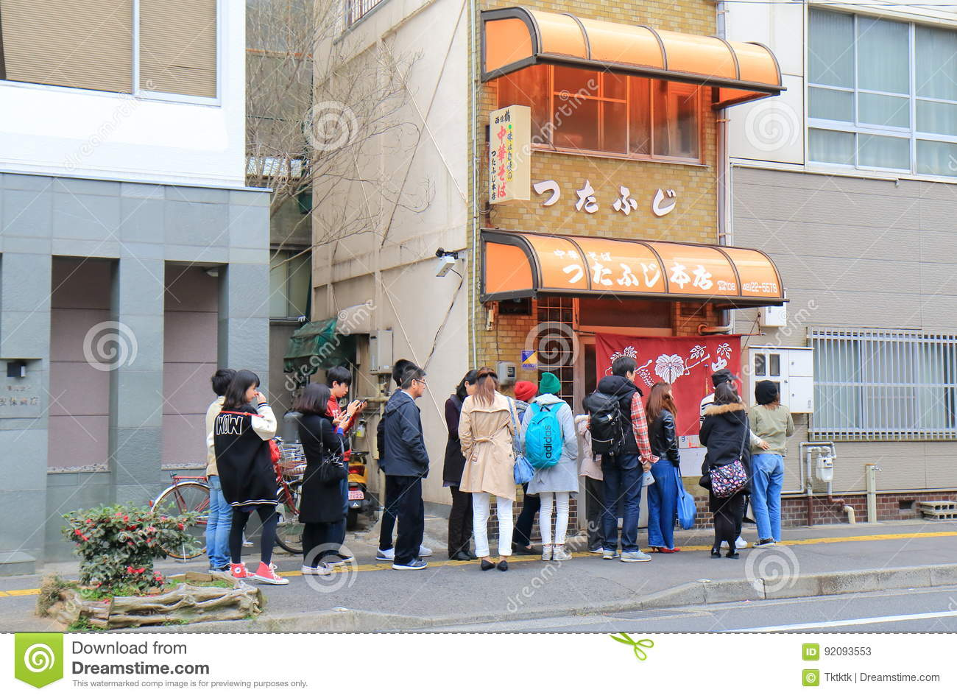

Concepts to explain events
Events is basically an abstraction on things that can happen during a program’s runtime.
EVENTS
Restaurant_customer_enter
Restaurant_customer_seating
Restaurant_customer_order
https://www.dreamstime.com/editorial-stock-photo-onomichi-ramen-noodle-shop-hiroshima-japan-people-queue-famous-tutafuji-famous-calf-image92093553
https://www.dreamstime.com/black-waiter-small-restaurant-operator-invites-customers-to-sit-dining-table-image208375155
https://www.dreamstime.com/stock-photography-taking-order-restaurant-image23320332
Notes:
Imagine if you will, a hectic restaurant.
What are the events that can occur here? A customer enters the restaurant; A waiter seats the customer to the next available seat. Waiter gets the customer’s order.
I’m sure you can imagine more events, but with just these few real world events, we have an idea on what event concept in programming.
Each event can be a function or series of functions.

Slide 12
Concepts to explain Django channels (consumers)
SyncConsumer
AsyncConsumer
WebsocketConsumer
AsyncWebsocketConsumer
JsonWebsocketConsumer
AsyncJsonWebsocketConsumer
EVENTS
Restaurant_customer_enter
Restaurant_customer_seating
Restaurant_customer_order
Notes:
In Django-channels, the consumer is the handler for events.
There are multiple kinds of consumers, from the low-level to high-level.
For this workshop, we’ll be using the JSON Consumers.

Slide 13

Concepts to explain Django channels (channel layer)
WS/WSS
Consumer
Channel Layer
WS/WSS
Consumer
https://commons.wikimedia.org/wiki/File:Django_logo.svg
Notes:
When a client connects to your server, an application instance is created inside the server. This instance is abstracted as a consumer.
The consumer is used to communicated between Django and the client.
However, there are times when you want to have different application instances communicated with each other. For example, in a chat room. This is where channel layers come in.
While you can use any backend for channel layers, Redis is currently the only officially maintained by Django for production use. Redis will be explained later.

Slide 14
Concepts to explain Django channels (channel GROUPs)
Channel Layer
Channel Groups
Channel Layer
Channel Layer
Channel Groups
Channel Layer
Notes:
Channel layers have a unique channel id or name when it is created. I will demonstrate this later.
Channel layers can join multiple groups.
Example usage: This allows for a single user who have multiple tabs or devices connected to receive channel messages without extra coding.
Another sample usage: This allows for “grouping” of events.
I will demonstrate both usage later.
Restriction: Group names are restricted to ASCII alphanumerics, hyphens, and periods only and are limited to a maximum length of 100 in the default backend

Slide 15
Concepts to explain Django channels (channel GROUPs)
Channel group names are restricted to ASCII alphanumerics, hyphens, periods and are limited to a maximum length of 100 in the default backend
Channel Layer
Channel Groups
Channel Layer
Channel Layer
Channel Groups
Channel Layer

Slide 16
Concepts to explain ASGI and WSGI
WSGI is the default web server gateway for Django
Has been around since pep-333 (year 2010)
Whenver a request connects, the Python application (example Django) is called once
Synchronous
ASGI is the spiritual successor to WSGI
Allows for long running connections such as Websocket
Supports asynchronous programming
Notes:
WSGI (pronounced Wiskey) is used to forward requests from a web server like NGINX to the python program.

Slide 17

Concepts to explain redis
Key-value database
Persistent
High availability
Backend for Django-channel layer
https://commons.wikimedia.org/wiki/File:Logo-redis.svg

Slide 18
Let’s start developing a simple chat server

Slide 19
development step-by-step
Let’s identify the events we will need for a chat program
Let’s create a Django app for chat
Let’s connect routing.py to asgi.py
Let’s create a url path for chat app
Let’s add Redis to settings.py
Let’s create consumer.py
Let’s create the html template for chat

Slide 20
development events for chat program
EVENT
chat.message {
“message”: message, }

Slide 21
development step-by-step
Let’s identify the events we will need for a chat program
Let’s create a Django app for chat
Let’s connect routing.py to asgi.py
Let’s create a url path for chat app
Let’s add Redis to settings.py
Let’s create consumer.py
Let’s create the html template for chat

Slide 22
development step-by-step
Let’s identify the events we will need for a chat program
Let’s create a Django app for chat
Let’s connect routing.py to asgi.py
Let’s create a url path for chat app
Let’s add Redis to settings.py
Let’s create consumer.py
Let’s create the html template for chat

Slide 23
development step-by-step
Let’s identify the events we will need for a chat program
Let’s create a Django app for chat
Let’s connect routing.py to asgi.py
Let’s create a url path for chat app
Let’s add Redis to settings.py
Let’s create consumer.py
Let’s create the html template for chat

Slide 24
development step-by-step
Let’s identify the events we will need for a chat program
Let’s create a Django app for chat
Let’s connect routing.py to asgi.py
Let’s create a url path for chat app
Let’s add Redis to settings.py
Let’s create consumer.py
Let’s create the html template for chat

Slide 25
development step-by-step
Let’s identify the events we will need for a chat program
Let’s create a Django app for chat
Let’s connect routing.py to asgi.py
Let’s create a url path for chat app
Let’s add Redis to settings.py
Let’s create consumer.py
Let’s create the html template for chat

Slide 26
development step-by-step
Let’s identify the events we will need for a chat program
Let’s create a Django app for chat
Let’s connect routing.py to asgi.py
Let’s create a url path for chat app
Let’s add Redis to settings.py
Let’s create consumer.py
Let’s create the html template for chat

Slide 27
development step-by-step
Run Redis and server
Let’s use asynchronous programming
Let’s add Django authentication
Let’s add periodic tasks with Celery
Let’s add global chat

Slide 28
development step-by-step
Run Redis and server
Let’s use asynchronous programming
Let’s add Django authentication
Let’s add periodic tasks with Celery
Let’s add global chat

Slide 29
Concepts to explain asynchronous and synchronous
Style of programming
Synchronous programming. Code is run one-at-a-time
Asynchronous programming. Code runs at the same time
Synchronous programming. Easier to maintain. Might be slower
Asynchronous programming. Harder to maintain. Might be faster
Notes:
Everyone started learning programming via synchronous programming.

Slide 30

Synchronous example Pride chicken wants to make breakfast
https://store.steampowered.com/app/1281400/Good_Knight/
Notes:
Disclosure: My brother and his team made Good Knight game

Slide 31
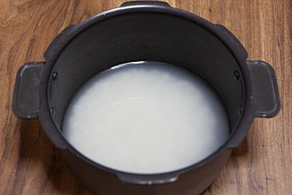
Synchronous example Pride chicken wants to make breakfast
1. Wash rice
https://store.steampowered.com/app/1281400/Good_Knight/
Notes:
Disclosure: My brother and his team made Good Knight game

Slide 32

Synchronous example Pride chicken wants to make breakfast
2. Cook rice
https://www.shutterstock.com/image-photo/jasmine-rice-cooking-electric-cooker-steam-1022661697
Notes:
Disclosure: My brother and his team made Good Knight game

Slide 33
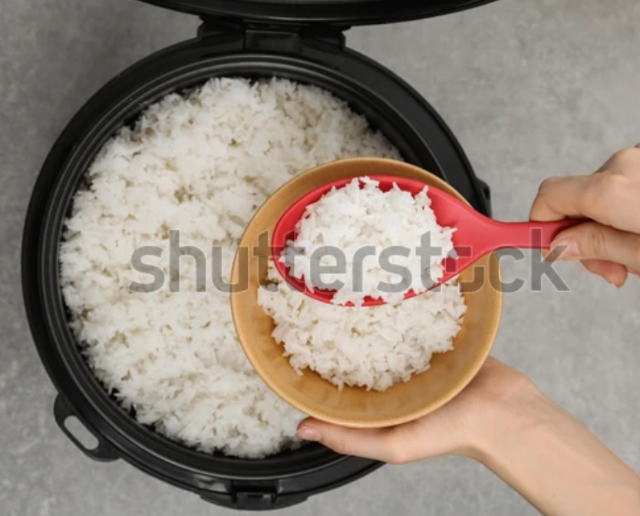
Synchronous example Pride chicken wants to make breakfast
3. Serve rice
https://www.shutterstock.com/image-photo/woman-putting-boiled-rice-into-bowl-1311652751
Notes:
Disclosure: My brother and his team made Good Knight game

Slide 34

Synchronous example Pride chicken wants to make breakfast
4. Cook bacon
https://tenor.com/view/bacon-cooking-yum-flavorful-pork-gif-13066812
Notes:
Disclosure: My brother and his team made Good Knight game

Slide 35
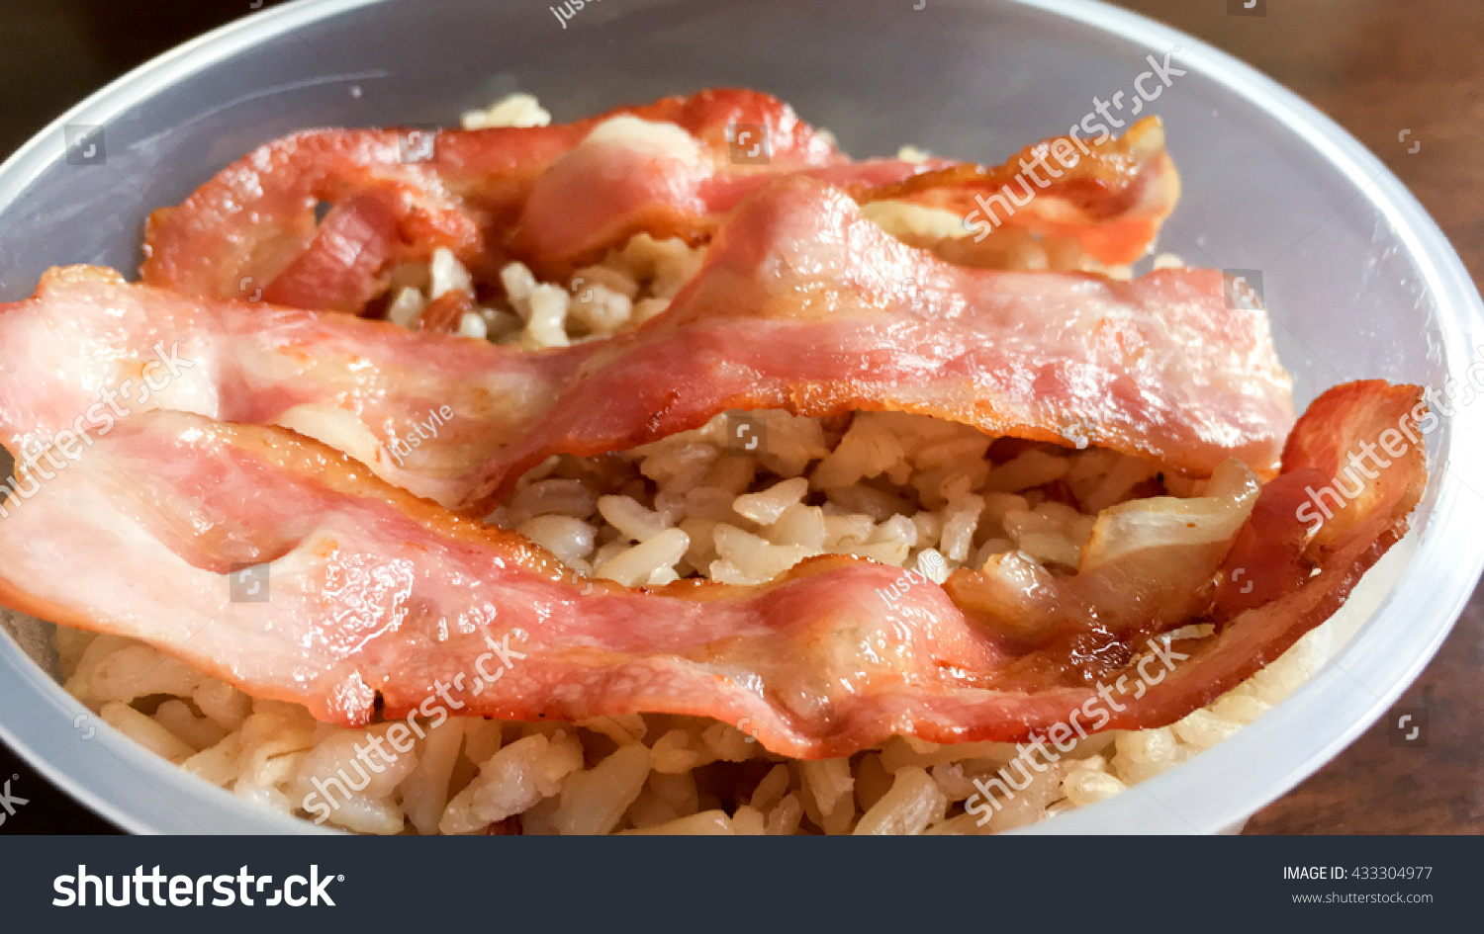
Synchronous example Pride chicken wants to make breakfast
5. Serve breakfast
https://www.shutterstock.com/image-photo/bacon-strips-rashers-over-brown-rice-433304977
Notes:
Disclosure: My brother and his team made Good Knight game

Slide 36
Concepts to explain asynchronous and synchronous
Synchronous programming might take a while, but it will finish
With Asynchronous programming, some tasks can be done in parallel.
In the next example, cooking rice and cooking bacon will be asynchronous
Notes:
Everyone started learning programming via synchronous programming.

Slide 37
aSynchronous example Pride chicken wants to make breakfast
https://store.steampowered.com/app/1281400/Good_Knight/
Notes:
Disclosure: My brother and his team made Good Knight game

Slide 38
Asynchronous example Pride chicken wants to make breakfast
A.1. Wash rice
B.1. Cook bacon
https://store.steampowered.com/app/1281400/Good_Knight/
Notes:
Disclosure: My brother and his team made Good Knight game

Slide 39
Asynchronous example Pride chicken wants to make breakfast
A.2. Cook rice
B.1. Cook bacon
https://store.steampowered.com/app/1281400/Good_Knight/
Notes:
Disclosure: My brother and his team made Good Knight game

Slide 40

Asynchronous example Pride chicken wants to make breakfast
A.3. Wait for bacon to finish
B.1. Cook bacon
Notes:
Disclosure: My brother and his team made Good Knight game

Slide 41
Asynchronous example Pride chicken wants to make breakfast
A.4. Serve rice
B.2. Done cooking
Notes:
Disclosure: My brother and his team made Good Knight game

Slide 42
Asynchronous example Pride chicken wants to make breakfast
C.1. Serve Breakfast
Notes:
Disclosure: My brother and his team made Good Knight game

Slide 43
Concepts to explain asynchronous and synchronous
Asynchronous programming can allow for parallel tasks,
But some tasks still need to wait for the result
And what used to be done step-by-step, multiple threads need to work together.

Slide 44
development step-by-step
Run Redis and server
Let’s use asynchronous programming
Let’s add Django authentication
Let’s add periodic tasks with Celery
Let’s add global chat
Notes:
$ del db.sqlite3

Slide 45
development step-by-step
Run Redis and server
Let’s use asynchronous programming
Let’s add Django authentication
Let’s add periodic tasks with Celery
Let’s add global chat

Slide 46
Concepts to explain Long running Background tasks
Examples:
Periodic tasks
Tasks that need to be run later
Django channels doesn’t fully support this
Recommendation: use Celery to create tasks and update the Channels

Slide 47

Concepts to explain celery
Functions are called: tasks
Celery can be used for scheduling tasks in the background
Is a separate system from Django
Execute tasks asynchronously

Slide 48
development step-by-step
Run Redis and server
Let’s use asynchronous programming
Let’s add Django authentication
Let’s add periodic tasks with Celery
Let’s add global chat
Notes:
$ celery -A pycon2023 worker -l INFO -P solo
$ celery -A pycon2023 beat -l INFO
If EOFError('Ran out of input’), delete celerybeat-schedule.*; ---
When Chuck Norris’ code fails, the compiler apologizes.
Chuck Norris don’t normally test his code. But when he does, he does it in production.
---
Different rooms don’t have global chat

Slide 49
development step-by-step
Run Redis and server
Let’s use asynchronous programming
Let’s add Django authentication
Let’s add periodic tasks with Celery
Let’s add global chat
Notes:
Demonstrate that it doesn’t work
Need to restart Celery.

Slide 50
development step-by-step
Run Redis and server
Let’s use asynchronous programming
Let’s add Django authentication
Let’s add periodic tasks with Celery
Let’s add global chat
Restarting Celery because of code changes is outside scope
But just be aware that it can happen.
Notes:
Demonstrate that it doesn’t work
Need to restart Celery.

Slide 51
chat challenge
Make the chat persistent.
Hint: Django have a database ORM you can use to save the chat logs.
Add a room list that users can click on instead of typing the room.
Allow for anonymous users to change their name
Add a user registration system
Add data for chat facts
Notes:
When Chuck Norris’ code fails, the compiler apologizes.
Chuck Norris don’t normally test his code. But when he does, he does it in production.

Slide 52
chat questions and answers
Before we continue to developing a simple game, do you have any questions?

Slide 53
Let’s start developing a simple game

Slide 54

development rock paper scissors
https://www.shutterstock.com/image-vector/rock-paper-scissors-icon-set-vector-1804156864

Slide 55
development rock paper scissors
Two teams: Red and Blue
Players are randomly given a team.
Each team have 10 seconds to choose a move.
The move with the highest votes (ties are randomly chosen from), will be played against the other team.
Players can change their names.

Slide 56
development rock paper scissors
Development style for this game
We will be using top-bottom.
This makes it easier for the audience to grasp the concepts.
Let me know in the feedback form or in-person later if this approach works for you.
Let’s look at the frontend we’ll be using.
Notes:
Development style
- Normally, I prefer a bottom-up approach to development.
- But for talks and workshops with an end product, I prefer top-bottom.
-- This makes it easier for the audience to grasp the concepts.
-- Let me know in the feedback form or in-person later if this approach works for you.

Slide 57
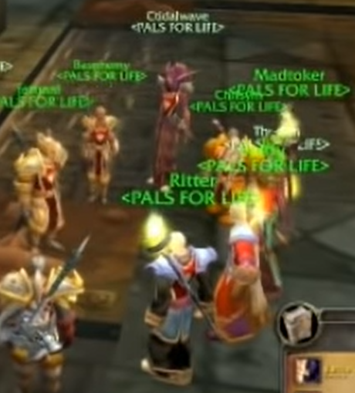
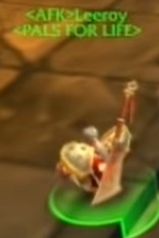
development Player id
Each connecting client should be assigned a player Id to identify them
For simplicity, we'll use channels.Consumer to hold our player Id
Notes:
https://www.youtube.com/watch?v=hooKVstzbz0

Slide 58
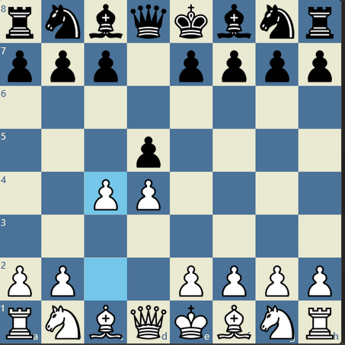
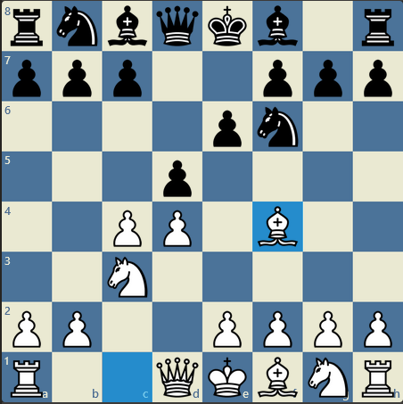
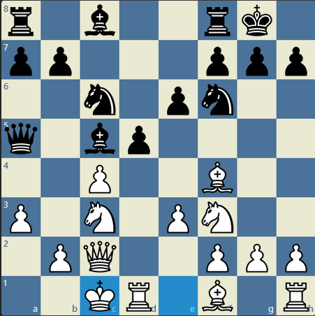
development Game state
In game development, Game state is the data that holds the game.
Let’s use Redis for holding the game state in memory
Notes:
https://www.chess.com/article/view/typical-positions

Slide 59
development game states
Player’s current team
Current time
Team votes for Rock, Paper, Scissors
Game state check (who won?)
Player names

Slide 60
development game events
Player’s current team
CHANGE_TEAM
Current time
UPDATE_GAME
Team votes for Rock, Paper, Scissors
UPDATE_GAME
Game state check (who won?)
UPDATE_GAME
Player names
UPDATE_PLAYERS

Slide 61
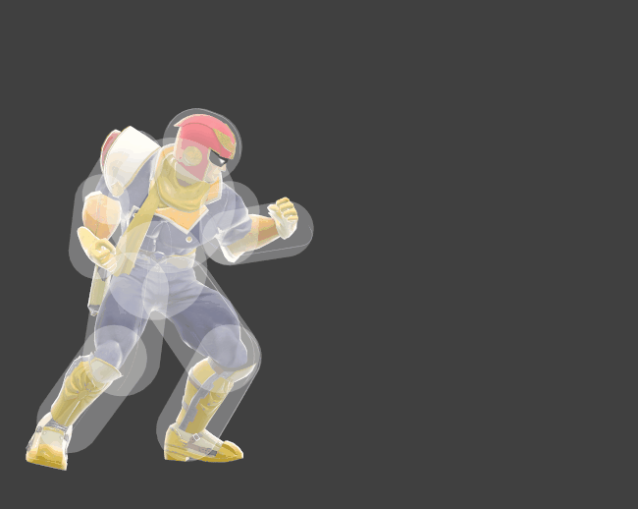
development Game Tick/Update
In game development, the Tick function handles the changes to the game state.
Ticks is called every X microseconds.
16.67ms for a 60 frames per second realtime game.
For this game, we’ll call an update every second.
Notes:
https://ultimateframedata.com/captain_falcon

Slide 62
development step-by-step
Let's add teams
Let's add timers
Let's add choosing a move
Let's add game state checks (who won?)
Let's add names

Slide 63
development step-by-step
Let's add teams
Let's add timers
Let's add choosing a move
Let's add game state checks (who won?)
Let's add names

Slide 64
development step-by-step
Let's add teams
Let's add timers
Let's add choosing a move
Let's add game state checks (who won?)
Let's add names

Slide 65
development step-by-step
Let's add teams
Let's add timers
Let's add choosing a move
Let's add game state checks (who won?)
Let's add names

Slide 66
development step-by-step
Let's add teams
Let's add timers
Let's add choosing a move
Let's add game state checks (who won?)
Let's add names

Slide 67
development step-by-step
Let's add teams
Let's add timers
Let's add choosing a move
Let's add game state checks (who won?)
Let's add names
Nice to have: reset player names

Slide 68
Rock paper scissors challenges (1/2)
Use Django's built-in user authentication
The timer is done on the backend,
Give the timer bar a smoother count down animation
Possible solution: The timer is done on the backend. Can it be moved into the frontend?
Possible consideration: There can be a potential timing mismatch on the backend and frontend. This can cause the bar to jump between server time and client time. Is there a way to minimize this?

Slide 69
Rock paper scissors challenges (2/2)
Better frontend
We used global variables. While this is fine for prototyping, It'll be hard to manage when adding new features. Can you find a better approach?
Suggestion: fork my github repository, then make changes. By forking, I can track what changes you have done. I'm genuinely interested in how you'll modify the code based on this talk.

Slide 70
Bonus time?

Slide 71
Learning more online notifications
If you want to keep track on who are online in the channel, you can use this Django app:
https://django-channels-presence.readthedocs.io/en/latest/

Slide 72
Learning more Use Reconnecting-WebSocket.js
Some platform like Heroku have timeouts.
https://devcenter.heroku.com/articles/http-routing#timeouts
There is a Javascript library for these environments.
https://github.com/joewalnes/reconnecting-websocket

Slide 73
Let’s make a realtime game with Django channels
MrValdez
Wakas

